Slide 1
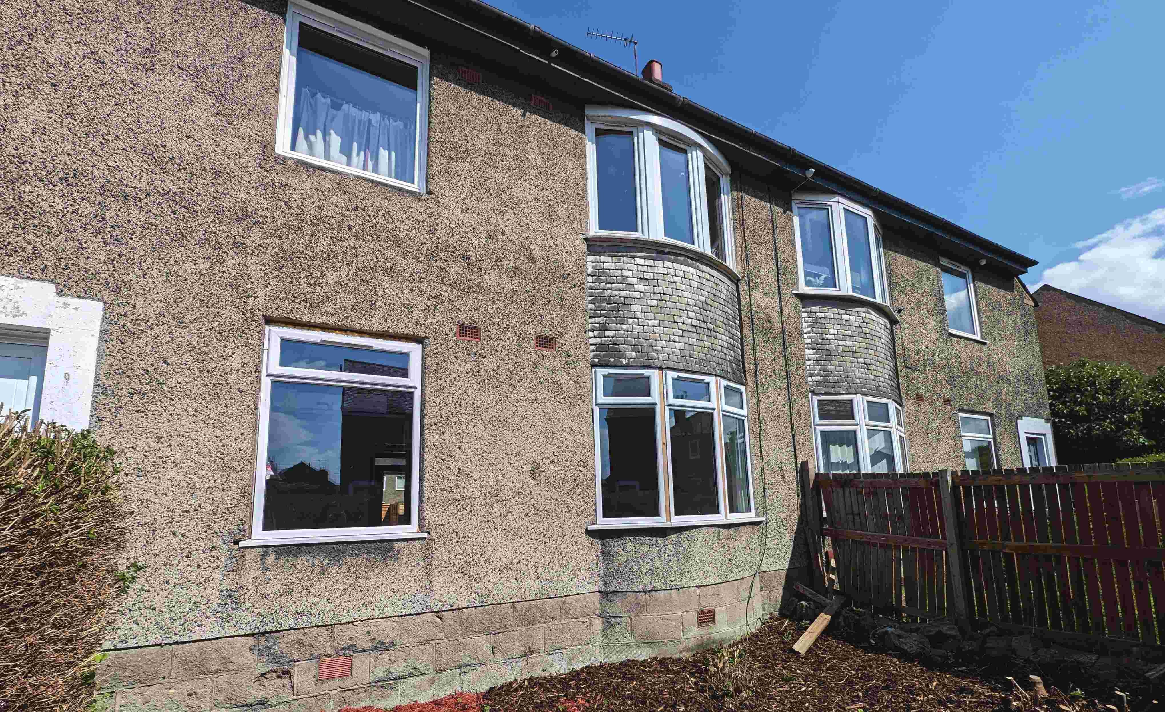
PI LT ON PLA CE
EDINBURGH
SOURCED B Y GLENHAM OFF MARKET ON BEHALF OF AN INVEST OR
ACCOMMODATION DETAILS
GROUND FLOOR LOWER VILLA FL AT LIVING ROOM, KIT CHEN X2 DOUBLE BEDROOMS STUDY, B ATHROOM
PRIV ATE FRONT AND REAR GARDENS
RESULTS 74% INC. IN CAPITAL VALUE
91% INC. IN RENT
14% ROCE

Slide 2
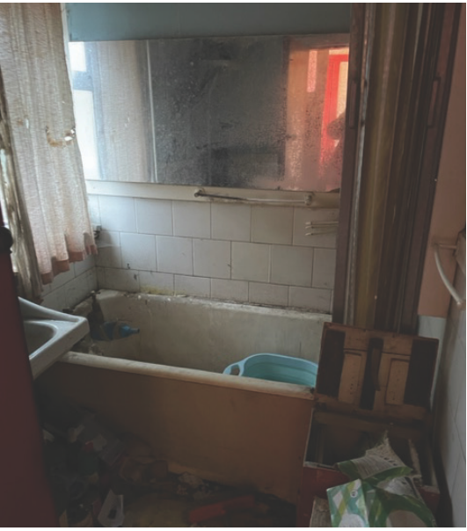
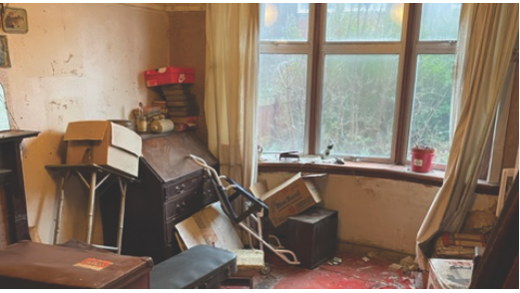
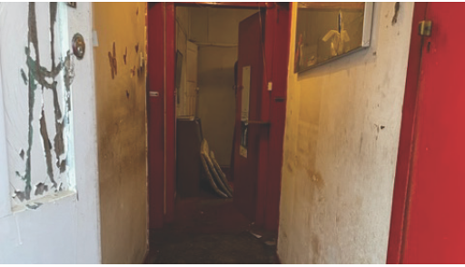
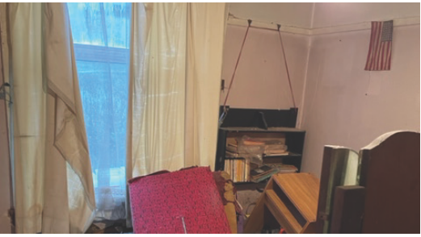
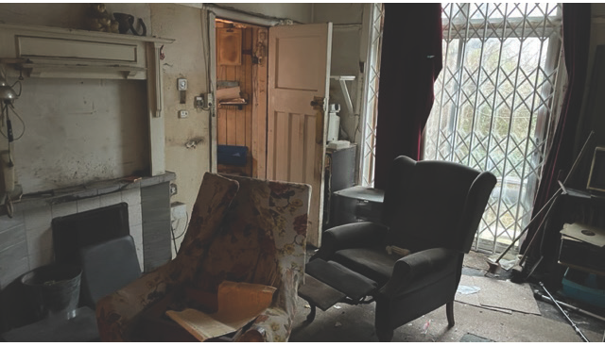
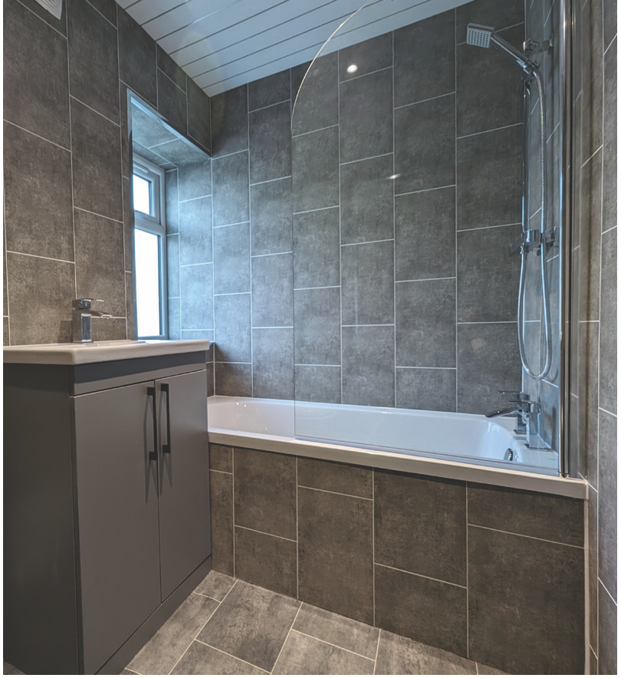
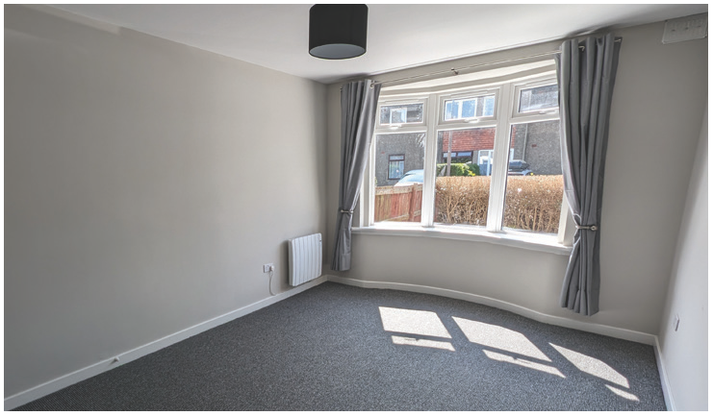
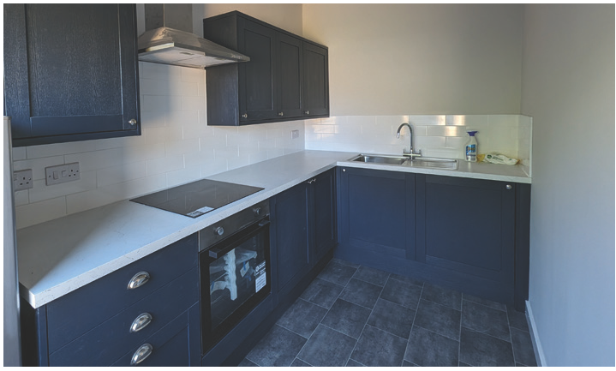
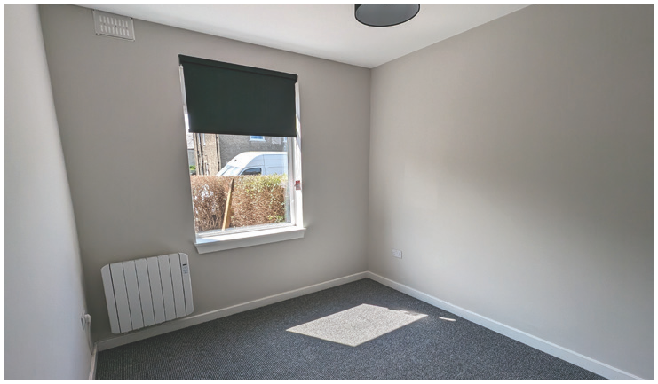
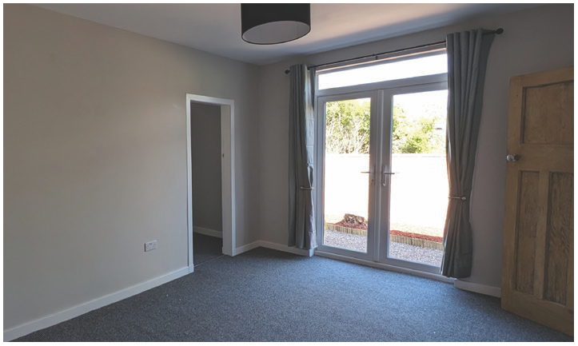
BEFORE
AFTER
REFURB DETAILS:
FULL REWIRE
NEW ELECTRIC HEATING NEW BATHROOM
NEW KIT CHEN
NEW WINDOWS AND FRENCH DOORS FULL REDECORATION
IMPROVED EPC FROM E T O C
V ALU ATION PRE REFURB: £120,000
PURCHASE PRICE: £112,000
RENTAL V ALU ATION PRE REFURB: £600 PM REFURB SPEND: £44,500
V ALU ATION POST REFURB: £190,000
RENTAL V ALU ATION POST REFURB: £1150 PM
YIELD ON CAPITAL EMPLOYED FOR REFURB: 14%

Slide 3





The ‘BRRR’ Model
Investors buying properties that are in bad condition and renovating them for rental is a well proven investment strategy, often know as the BRRR model. This stands for buy, renovate, rent, refinance. It is a dynamic strategy designed to grow a portfolio and generate wealth through strategic acquisition, renovation, and financing. So how does it work?
Buy: The investor buys a distressed property at a good price normally due to the level of work required to bring the property up to an acceptable standard for letting.
Renovate: The aim is to refurbish the property to improve its capital value but also more importantly increase its rental income. This can range from just a lick of paint to reconfiguring the property to add bedrooms and everything in between. The critical thing here is to intimately know the local market and to make sure the figures stack up.
Rent: Once the property has been renovated it will be ready to advertise and let. The amount of prior research and analysis put into the project will determine success in this stage.
Refinance: Once a property’s value has increased, there is the option to refinance the mortgage and pull out a portion of the initial investment and any additional equity gained through renovation. This is based on the increase in the capital value and the higher rental income generated.
It sounds easy and of course when carried out correctly can be a fantastic way for investors to acquire income-generating properties, benefit from their appreciation and speed up the process of building a portfolio.
Risks: But although the strategy sounds simple it is in fact highly complex and comes with significant risks. As such anyone wanting to utilise this approach must fully understand what these are and seek ways of mitigating against them. The main risks are paying too much for a property, underestimating the costs associated with refurbishment and overestimating the end rental income along with the value of the property post renovation.
The Glenham Approach: At Glenham we fully understand all the risks and work with our clients to mitigate these by utilising our intimate knowledge of the local market, sophisticated investment analysis models, our many years of running renovations and our network of trustworthy contractors. We work closely in partnership with our investors and have a proven track record with many successful examples of BRRR under our belt.
Contact Us
If you would like to chat further about how Glenham can help: Tel: 0131 557 5101
Email: enquiries@glenhamproperty.co.uk

